Slide 1
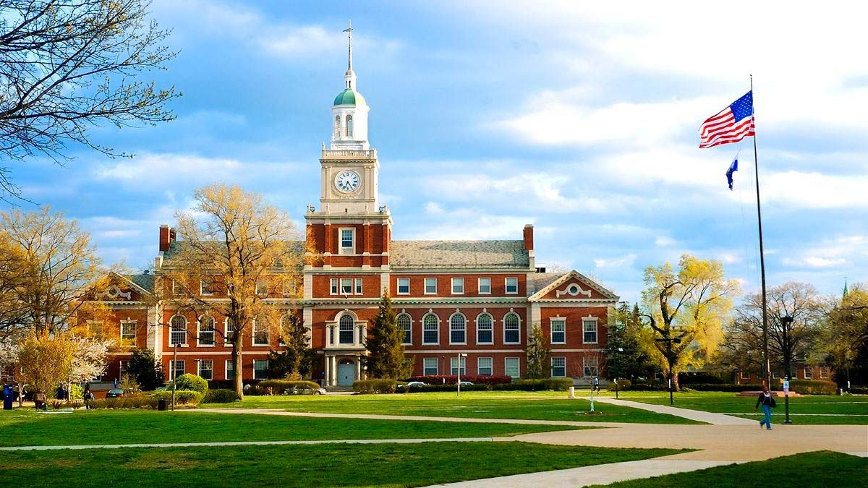
University Recommendation System
CSCI-5270-201 - Machine Learning
BY: AMIT MAHARJAN

Slide 2

Overview
Introduction - What? Why? How?
Motivation
Problem
Solution
Implementation
Data Preprocessing
Model Development
Results
Conclusion
Reference List

Slide 3
Introduction - What? Why? How?
Predict university’s decision for graduate admission
Application process is daunting for international students
Build classification models for prediction

Slide 4

Motivation
United States is a premier destination international students
Application process is challenging for individual
Time and financial constrain
Apply to 10-15 universities at most [1]
Develop a University Recommendation System using predictive analytics and supervised learning algorithms
Identify best university based on the profiles

Slide 5

Problem
Thousands of universities [2]
Not feasible to apply to all of them
Application Fee - $30 to $135, with an average of $74 per application [3]
10 universities could cost $740
Official GRE and English Proficiency Test scores
GRE scores costs $35 [4]
TOEFL scores cost $25 [5]
If 5 university needs test scores, $300 is added to total expenses
Total: $740 + $300 = $1040
NRP 139,067.76

Slide 6

Solution
Reduce the time and financial resources invested by international students in applying to universities
Assist international students in identifying suitable universities for graduate studies in the United States based on their unique profiles and preferences

Slide 7
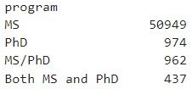

Implementation - Data Preprocessing
Drop unwanted columns: userName and userProfileLink
Removed missing values
Removed outliers - Isolation Forest
Handled Inconsistent data

Slide 8
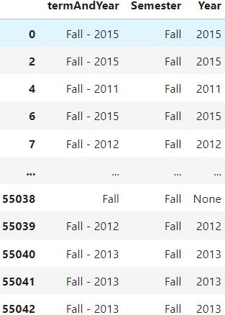
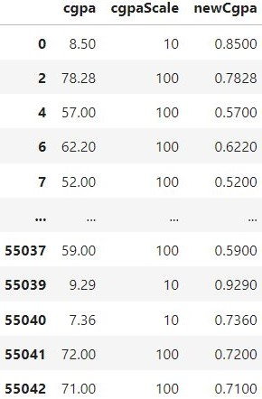
Implementation - Data Preprocessing
Feature Extraction

Slide 9
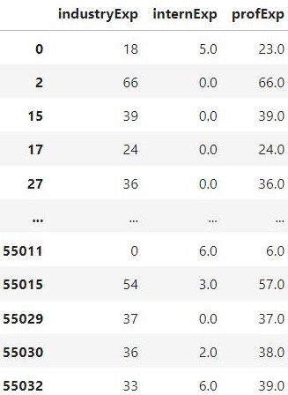
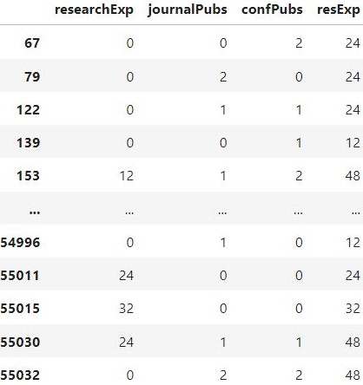
Implementation - Data Preprocessing
Feature Extraction

Slide 10
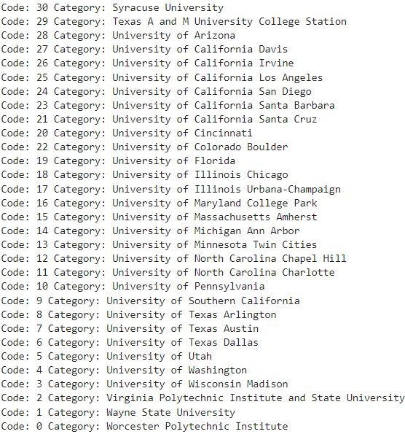
Implementation - Data Preprocessing
Encoding categorical data
One Hot Encoding - Program, Semester
Label Encoding - Year, University Name

Slide 11
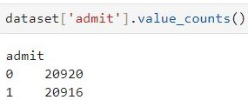
Implementation – Model Development
Standardize Features
Building and Training ML Models
Logistic Regression
Decision Tree
Random Forest
Support Vector Machine (SVM)
K Nearest Neighbors (KNN)
Naive Bayes
Testing the ML Models
Use 25% of data for testing
No Cross-Validation
No PCA
StandardScaler

Slide 12

Results - Accuracy
Logistic Regression - 53.53%
Decision Tree – 63.88%
Random Forest - 63.75%
Support Vector Machine (SVM) - 56.64%
K Nearest Neighbors (KNN) - 55.53%
Naive Bayes - 52.72%

Slide 13
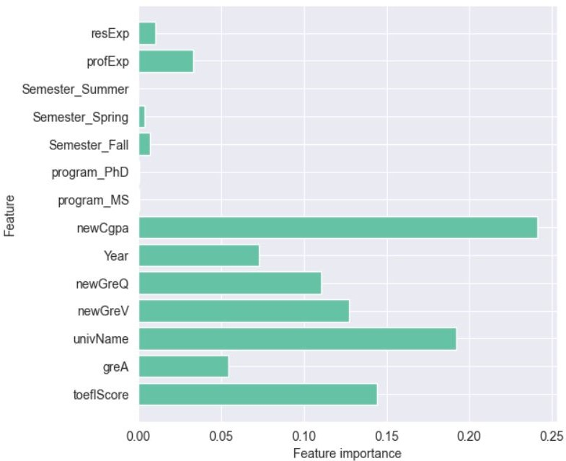
Feature Importance

Slide 14
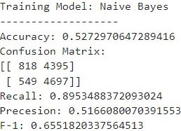
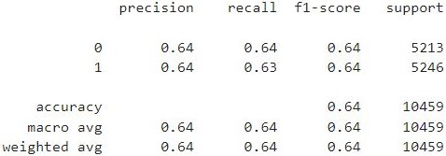
Decision Tree & Naive Bayes

Slide 15
My Result
Accept
Arizona State University
Clemson University
George Mason University
New Jersey Institute of Technology
Reject
Columbia University
New York University
Princeton University
University of Texas Austin

Slide 16

Conclusion
Developed effective recommendation system
Improve decision making for international students
Decision Tree is better in terms of Accuracy
Naive Bayes is better in terms of Recall
Lessons Learned
Six different supervised algorithm
Data preprocessing techniques
Importance of scaler and normalization
Deal with additional data after the model is built
Encoding techniques
Difficult – Data Preprocessing
Done differently – Major column and Department column
Future Work – LOR and SOP

Slide 17

Reference List
[1] How Many Colleges Should You Apply To? | Coursera. (n.d.). Retrieved February 25, 2024, from https://www.coursera.org/articles/how-many-colleges-should-i-apply-to
[2] How Many Universities Are in the U.S. and Why That Number Is Changing. (n.d.). Retrieved February 25, 2024, from https://www.usnews.com/education/best-colleges/articles/how-many-universities-are-in-the-us-and-why-that-number-is-changing
[3] College Application Fees: What It Costs to Apply | BestColleges. (n.d.). Retrieved February 25, 2024, from https://www.bestcolleges.com/research/college-application-fees-how-much-does-it-cost/#graduate-application-fees
[4] Sending Your GRE General Test Scores. (n.d.). Retrieved February 25, 2024, from https://www.ets.org/gre/test-takers/general-test/scores/send-scores.html#accordion-d35ebe9746-item-75f4d8a94c
[5] Sending Your TOEFL iBT Scores. (n.d.). Retrieved February 25, 2024, from https://www.ets.org/toefl/test-takers/ibt/scores/send-scores.html

Slide 18

Thank you !!

